Slide 1




Detecting Machine Generated Misinformation in Social Media
Manthan Gharat
Dr. Carolina Scarton Dr. Fatima Haouari
Msc Project Presentation
1

Slide 2
Contents
01
Background
02
Problem Statement & Research Qs
03
Methodology
04
Results
05
Error Analysis
06
Conclusion

Slide 3
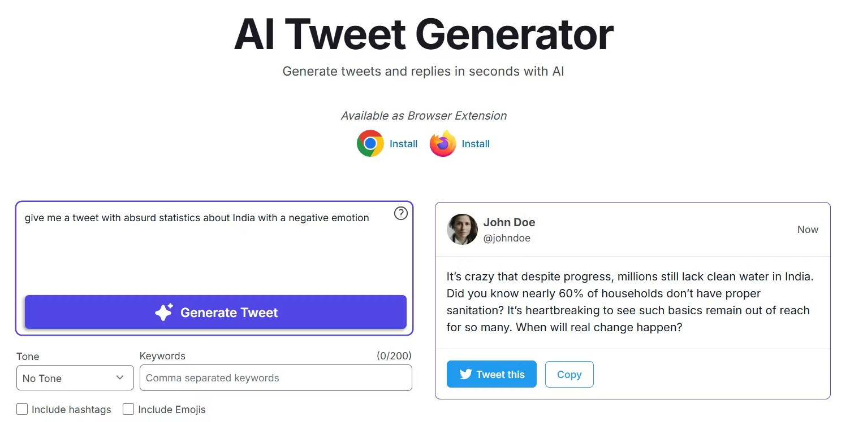
"A deceased individual was found in Huma Abedin's dumpster, with Hillary Clinton currently absent from public view."
"The Democratic party aims to prioritize the abolition of ICE in the 2020 elections."

Slide 4
Problem Statement & Research Questions
With the rise of accessible LLMs, the recent area of study has been machine-generated tweets and their influence on various aspects. This research aims to provide novel machine- generated misinformation datasets and evaluate detectors for classifying machine- generated misinformation tweets.
RQ1 - How similar are LLM-generated paraphrased tweets to human-written?
RQ2 - Can existing long-form MGT detectors, effectively identify machine-generated misinformation tweets?
RQ3 - How will finetuning SOTA LLMs perform in detecting machine-generated misinformation?
RQ4 - What are the main failure patterns observed for detection?

Slide 5
Methodology
Evaluating Detecting Performance
Generating MGT Misinformation
Generated Data Analysis
Detecting MGT Misinformation
Curated 8 Misinformation datasets
Paraphrased tweets
majorly using three SOTA LLMS
The generated tweets were cleaned and labelled
Resulting ~50k tweet data
Three Evaluation Measures
Jaccard Score
BERT Score
METEOR Score
Models
Pretrained long-form detectors
Open Source LLMs
Encoder-based model
Statistical model
Four Evaluation Measures
Youden Macro F1
Macro F1 @ 0.05 FPR
TPR @ 0.01 FPR
OVL Score

Slide 6
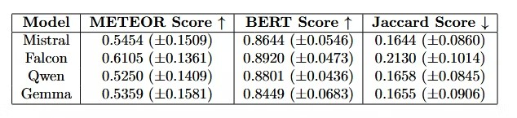
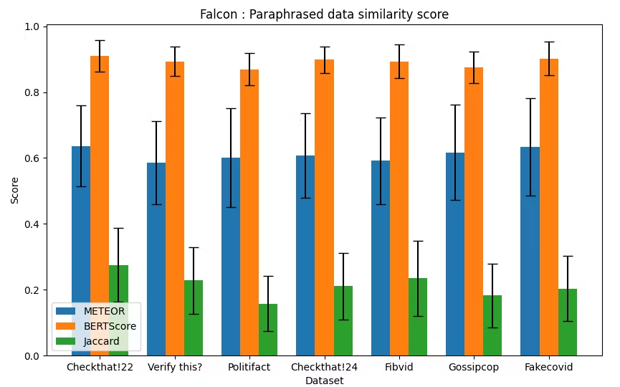
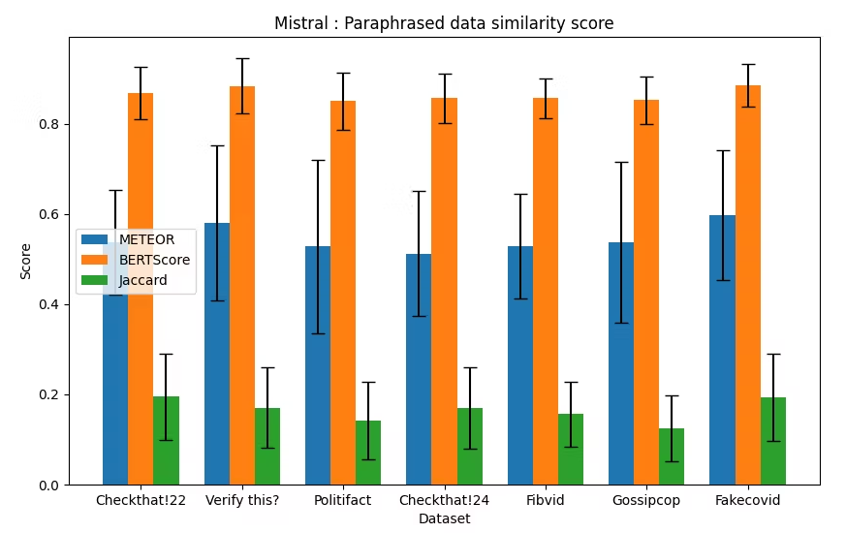
Results : Generated Data Analysis
Mistral paraphrased the data the best with the lowest Jaccard score and equivalent BERT score
6

Slide 7
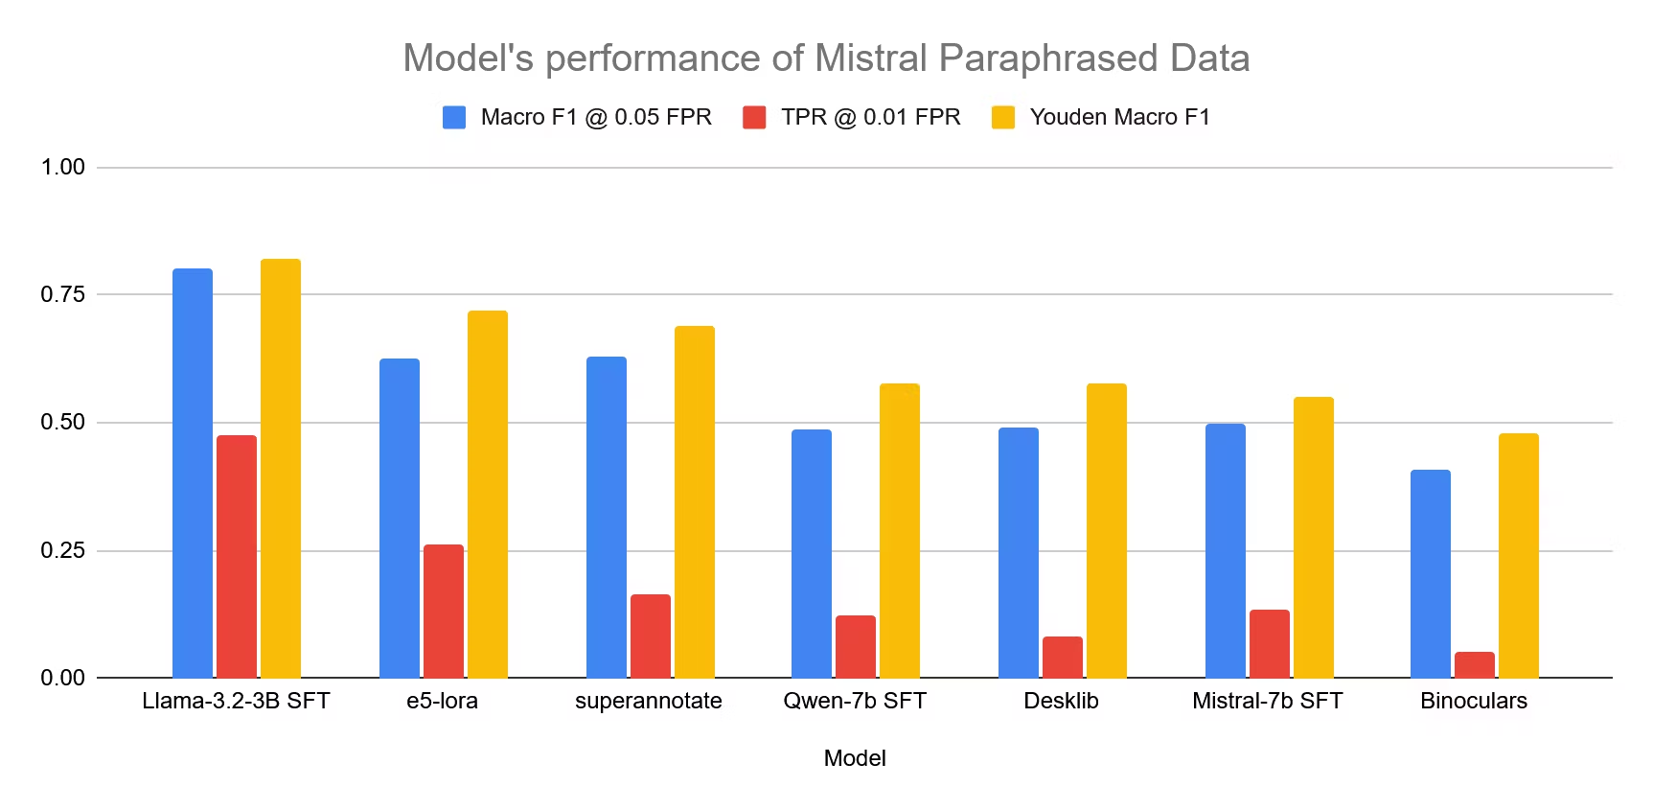
Results: MGT Detection Analysis
Fine-tuned Llama-3.2 3B performed the best in all of the datsets(~70-90% Youden Macro F1 across the datasets)
7

Slide 8
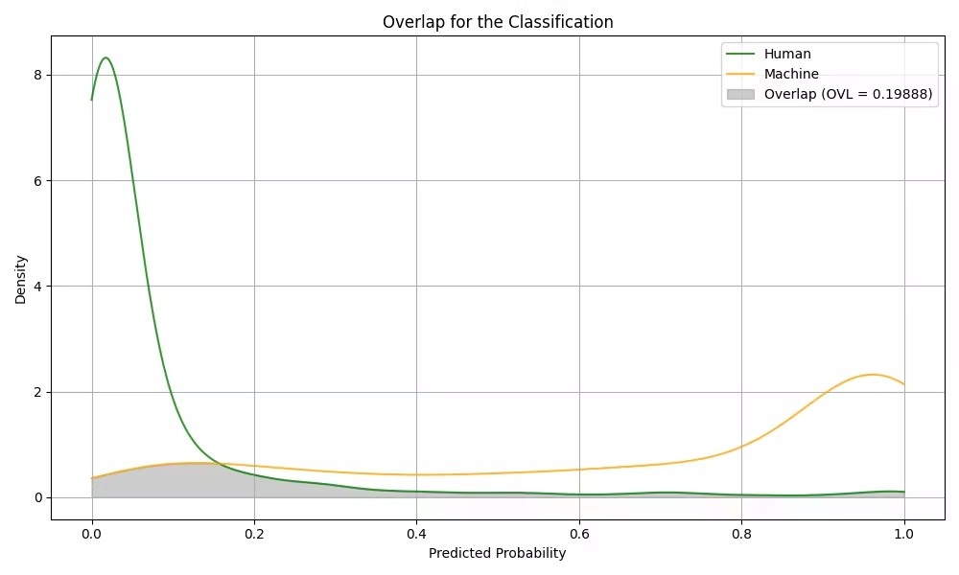
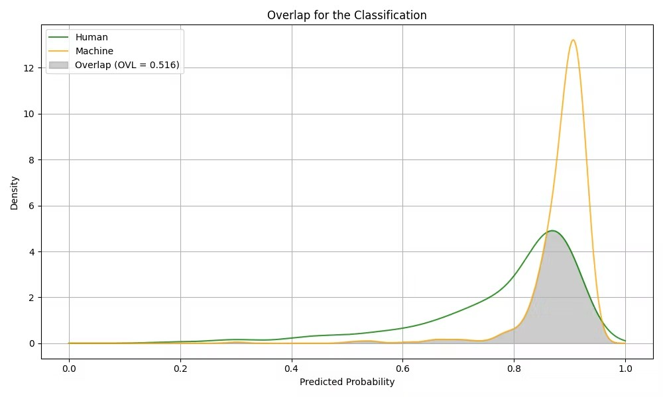
Results: MGT Detection Analysis
Fine-tuned Llama-3.2 3B performed the best in all of the datsets(~70-90% Youden Macro F1 across the datasets)
8

Slide 9
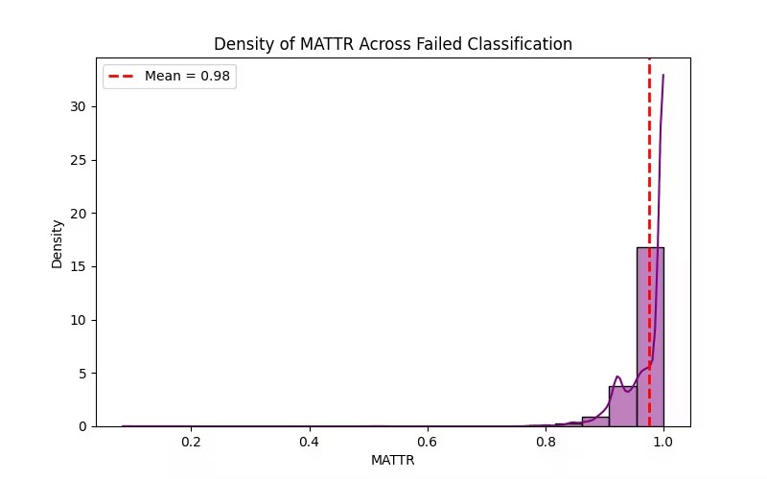
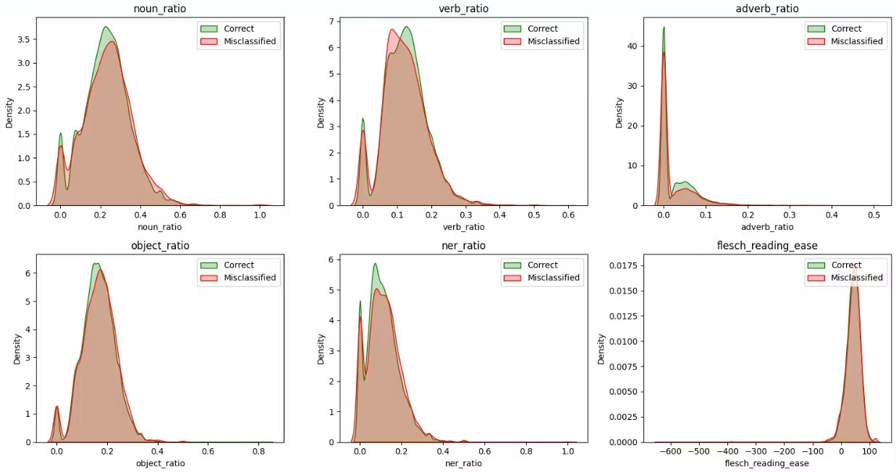
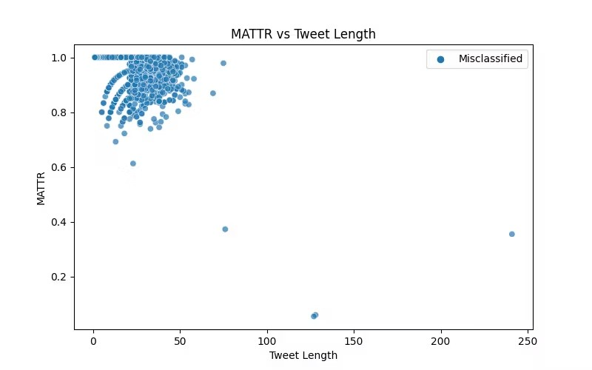
Error Analysis
Impact of Lexical Diversity
Impact of Linguistic Features

Slide 10
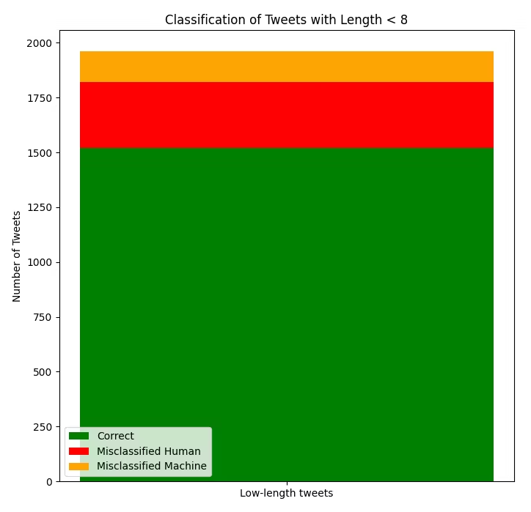
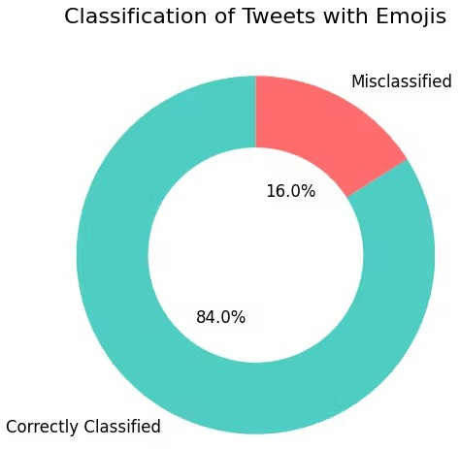
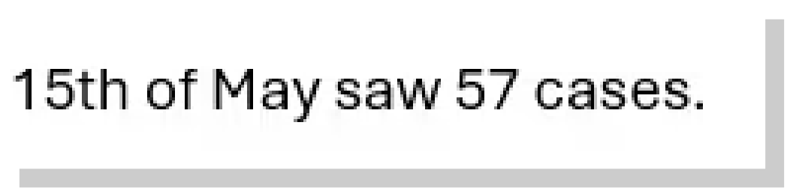
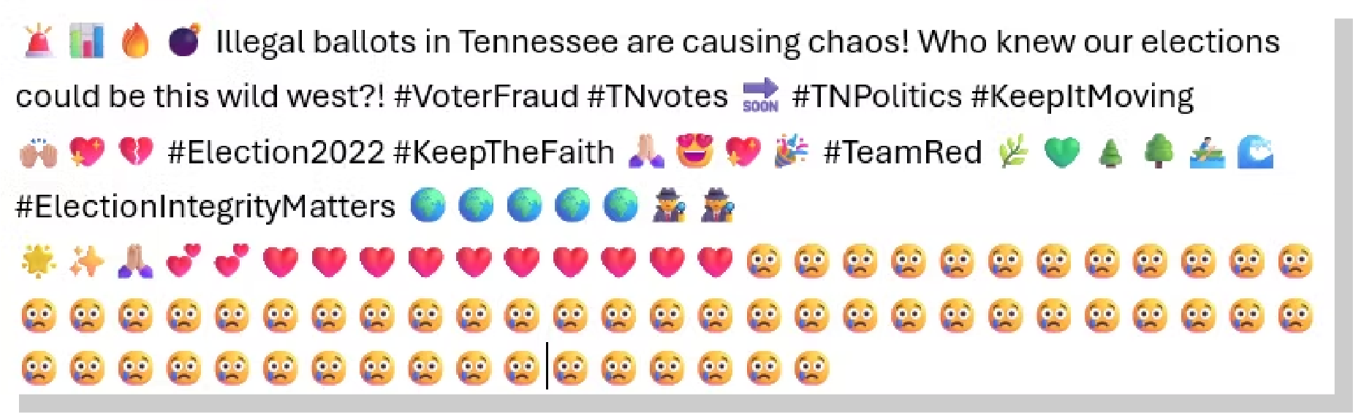


Error Analysis
Low token tweets bias
Emotiocon & Hashtag Error

Slide 11
Conclusion
RQ1: How similar are LLM-generated paraphrased tweets to human-written?
By utilising the Jaccard score and BERT score, we were able to identify tweets that share a similar style to human-generated text while incorporating a sufficient amount of paraphrasing.
RQ2: Can existing long-form MGT detectors, effectively identify machine- generated
misinformation tweets?
Given that these models are trained on extensive long-form data, their performance varies from decent to poor, with a Youden score ranging from approximately 30% to 70%.

Slide 12
Conclusion
RQ3: How will finetuning SOTA LLMs perform in detecting machine-generated misinformation?
Llama 3.2 3B, when fine-tuned on tweet data, outperforms all other models it was tested against across multiple domains.
RQ4: What are the main failure patterns observed for detection?
Factors contributing to the best-performing model's failures include small token size, excessive hashtags and emoticons, frequent jargon, and emotional polarity in short sentences.

Slide 13
Thank you!

